Slide 1

Enhancing EV Battery Recycling: A Novel Approach to Discharge Optimization
Implementing MPC and PI Control Policies to Streamline Battery Discharge and Ensure Constant Temperature Levels
Adam Burman
Chalmers University of Technology
2024-04-11

Slide 2
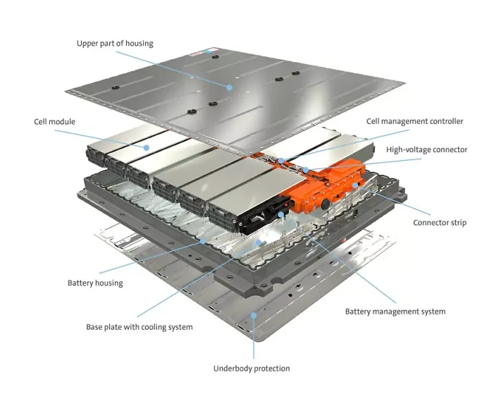
Introduction to the thesis project
Current industry method of disposing EoL Batteries
The idea behind the master’s thesis
First idea: Neural Networks and Black Box
Current idea: PI and MPC, Gray/White Box
Notes:
65% increase in demand for LiB from 2021 to 2022 to 550 GWh and as stated in mail 400 GWh sold last year and projection 2030 2000GWh
The current industry involves low discharge rate. Pros safe, cons slow

Slide 3
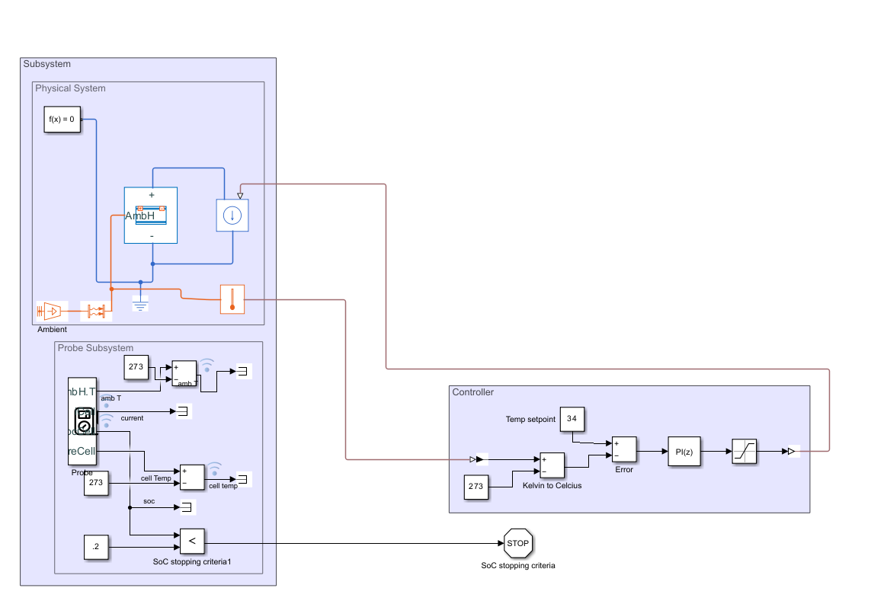
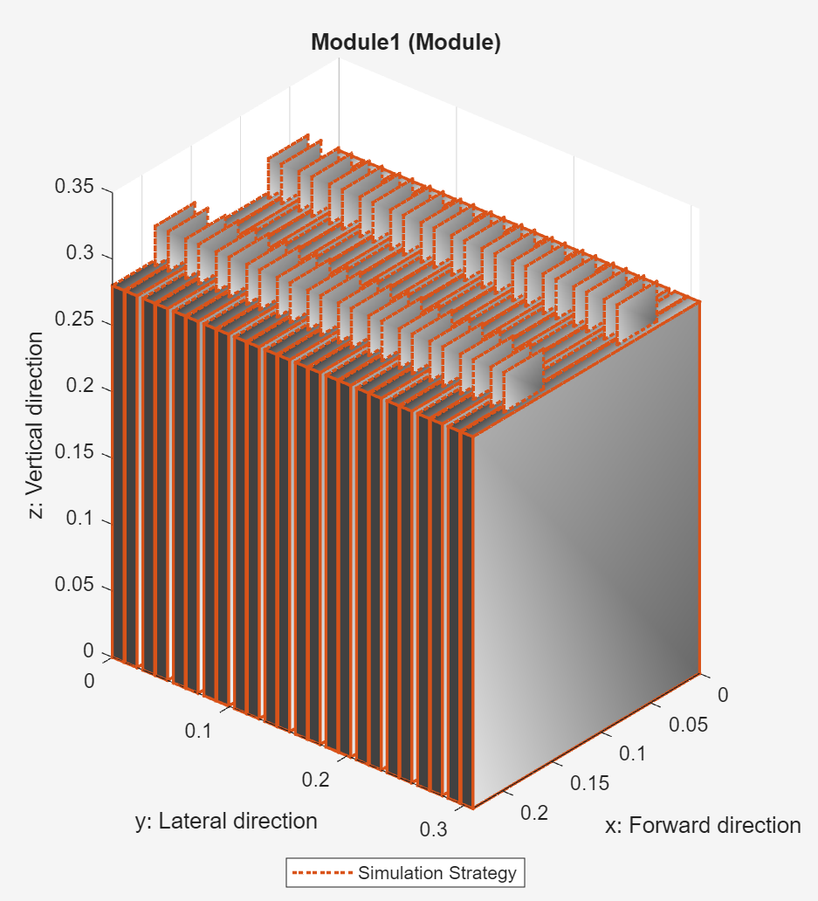
Battery building & Simulation in Simulink/Simscape
Easy to build and edit
Based on specifications
No parameters to estimate

Slide 4


Slide 5
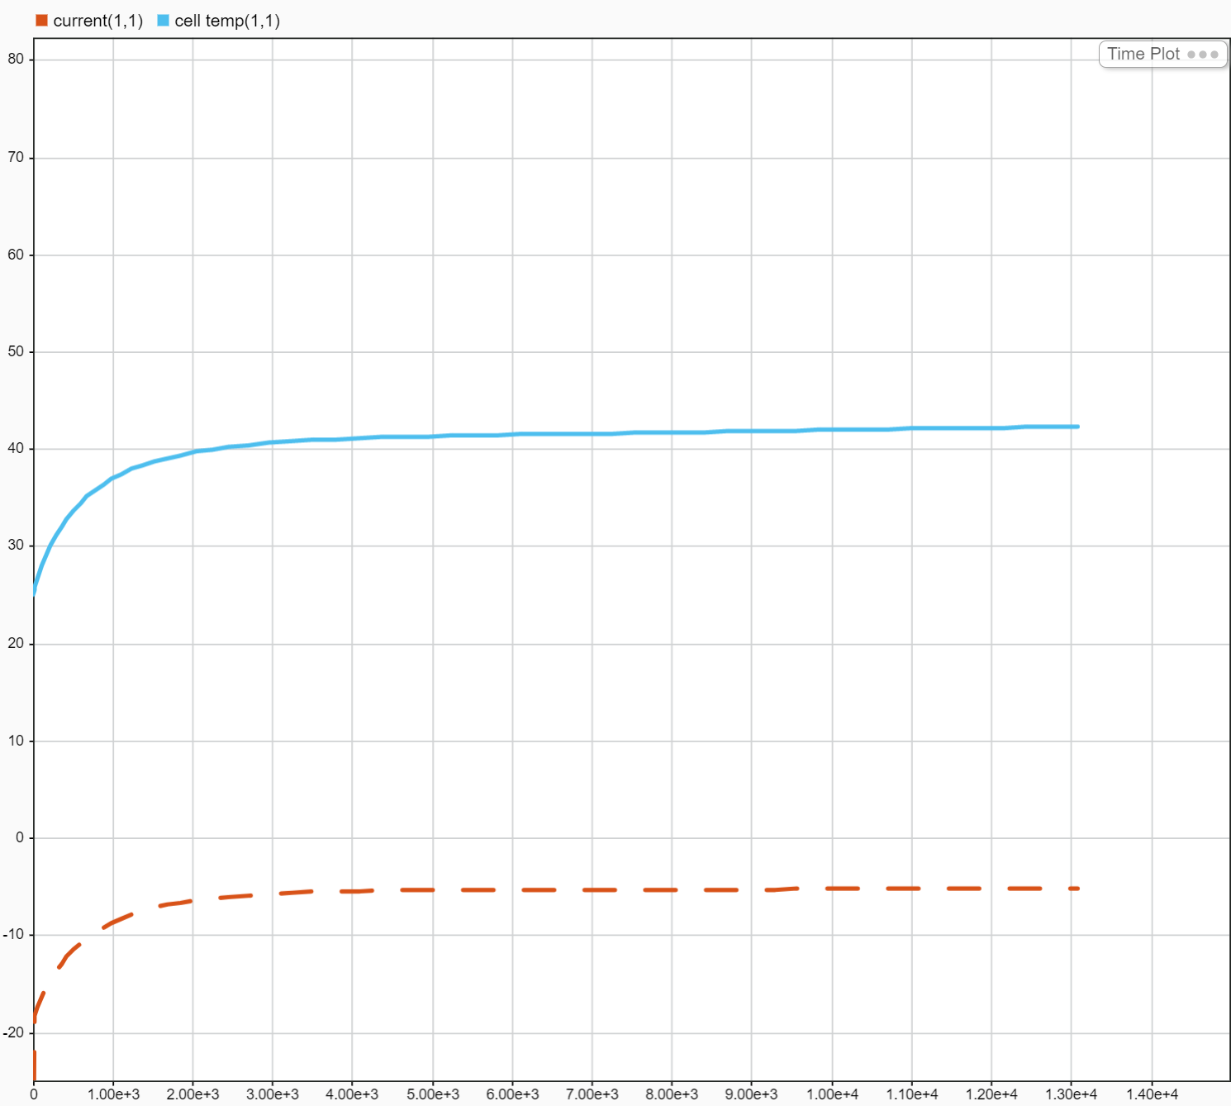
Issues with this model
Black box in terms of battery modelling
Many parameters not known
Linearization
MPC

Slide 6
Going forward
Existing data?
If yes: Simplified model and estimate parameters
If no:
Find reliable module model (PyBaMM)
Limitations in evaluation
Low current output
Time constraints and slow response
MPC
Key differences between charging and discharging

Slide 7

Thank you for listening!
Questions?

